Slide 1

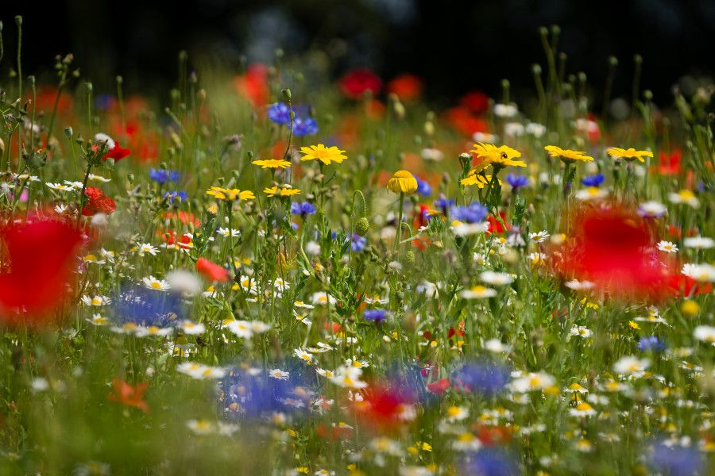
Growing Wildflowers
From Seed to Seeds
www.edenproject.com/schools

Slide 2

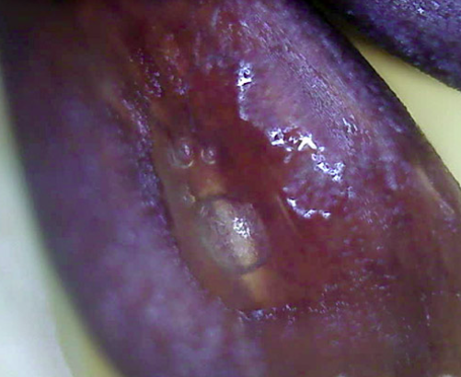
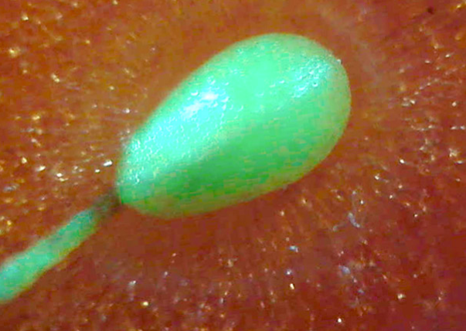
Zoom in, Zoom out
https://explorify.uk/en/activities/zoom-in-zoom-out/brown-shapes/classroom
https://explorify.uk/en/activities/zoom-in-zoom-out/red-and-bumpy/classroom

Slide 3
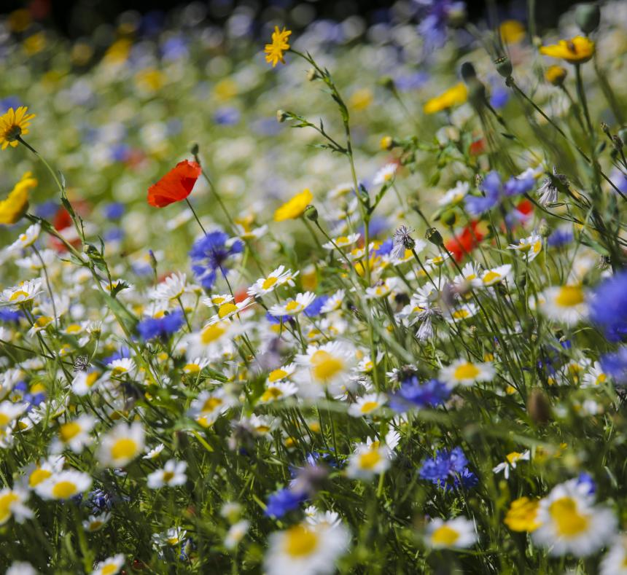
Outcomes for today:
During this lesson, you will:
Compare different types of seeds.
Understand what plants need to grow.
Learn why wildflowers are really important.
Sow your own wildflowers and watch them grow!

Slide 4
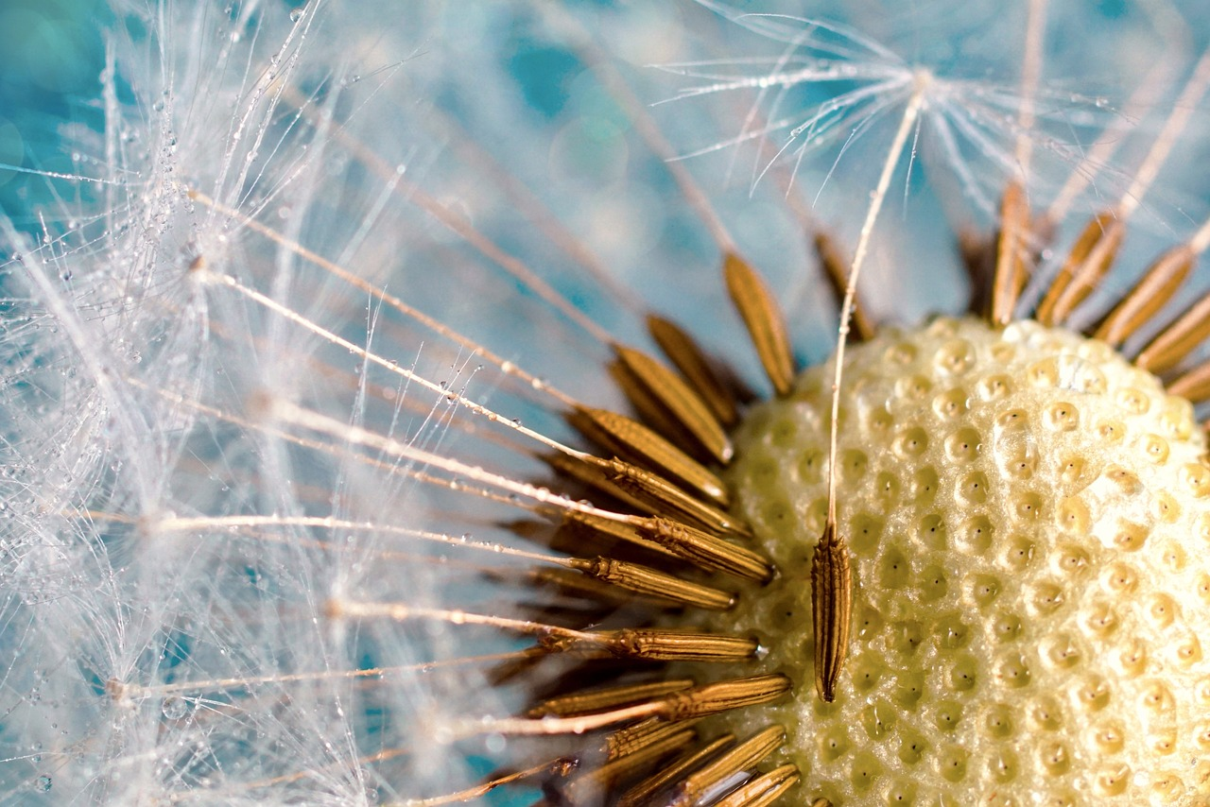
What is a seed?
Why do plants have them?

Slide 5
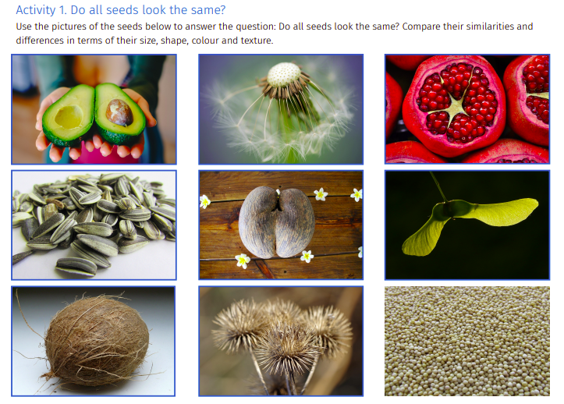
Do all seeds look the same?
Activity 1
Study a selection of different seeds. Can you spot any similarities? Can you see any differences?
Are they the same size?
Are they the same shape?
What about their colour?
Do they feel the same?

Slide 6

Extension Activity
Go on a seed hunt around your school. Look out for different plants and trees and see how many of them are growing seeds.
You could take photographs of all the different seeds you find or, with the help of an adult, collect some seeds to bring back to class.

Slide 7
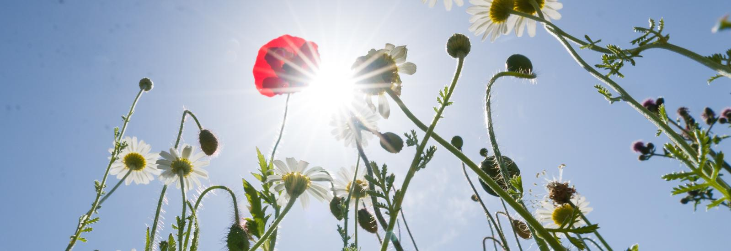
Main Activity
Today, you will be working in groups to plant wildflowers somewhere around your school ground.

Slide 8
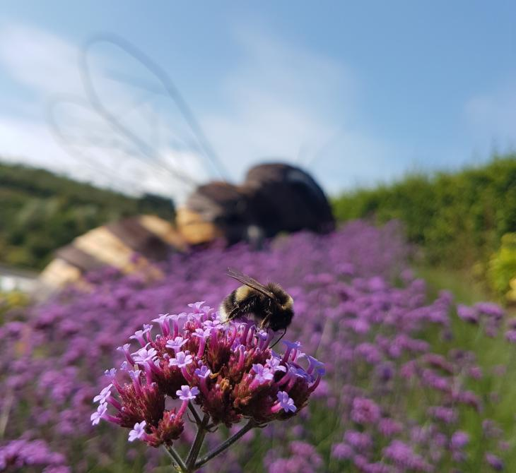
Why wildflowers?
There are lots of good reasons to plant wildflowers:
Connecting people with nature.
Changing unused spaces into bright, colourful places.
Increasing the amount of different plants and animals in one place.
Help pollinators (such as bees) that are currently under threat.
Did you know?
The number of pollinators we have in the world has dropped a huge amount over the past ten years! This will effect the food we are able to grow and eat!

Slide 9
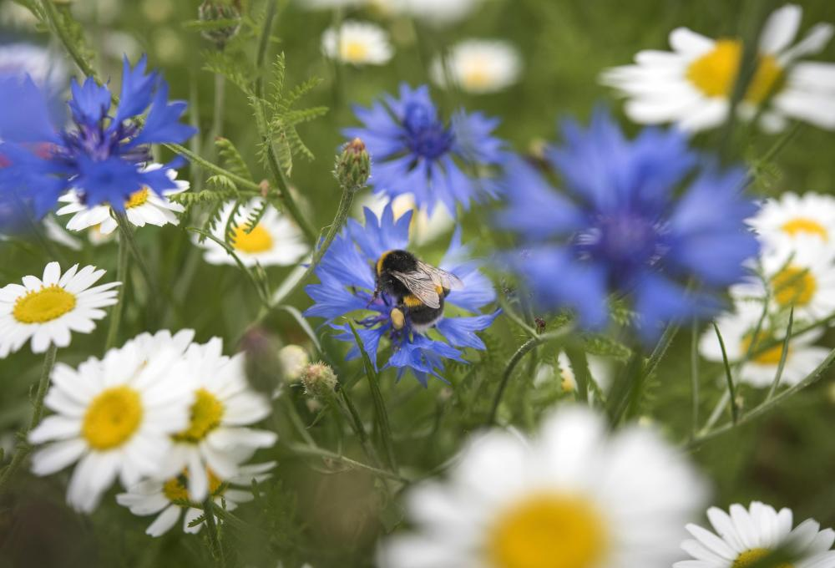
But don’t worry! You can help!
We can create special safe spaces for these mini-beasts by planting wildflowers!
However, before we can sow our wildflowers, you need to think carefully about what plants need to grow. This will help you to choose a good spot to sow your seeds.

Slide 10

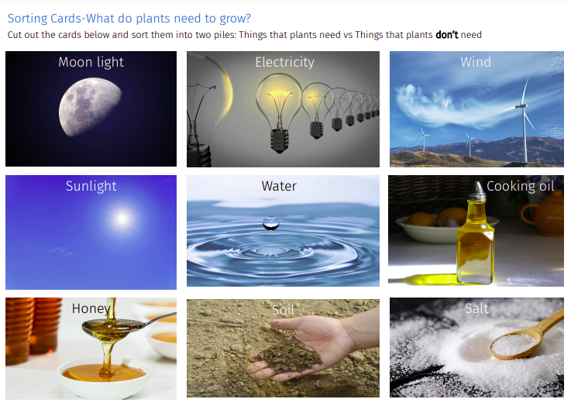


Activity 2
In your groups, sort your cards into two piles:
things plants need.
things plants don’t need.
Extension: ‘Bloom or Doom- The Seedling Game’

Slide 11
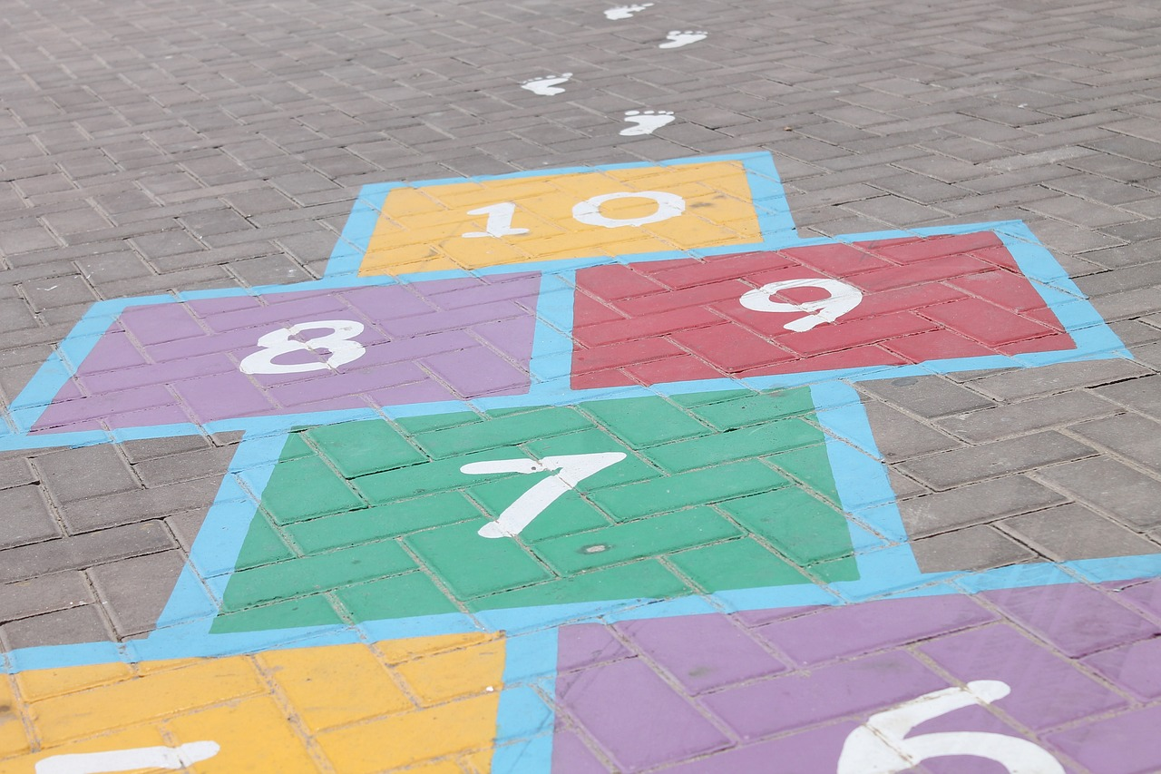
Where is your group going to sow your wildflowers?
Explore your school grounds and pick a place for your group to sow your wildflower seeds.
Remember to find a place that will give your seeds all of the things that they need to grow (you may need to give them a helping hand with the watering)

Slide 12
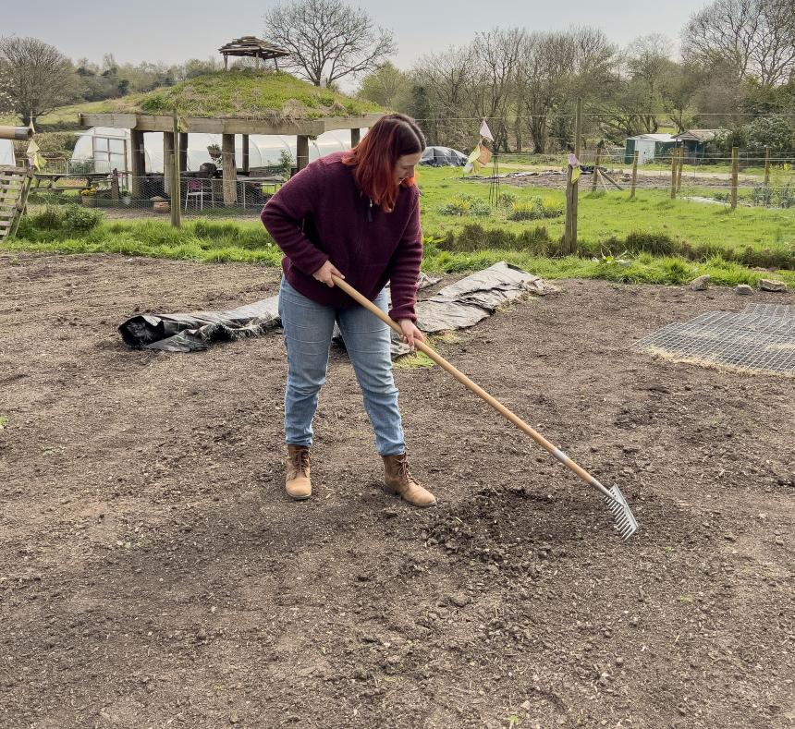
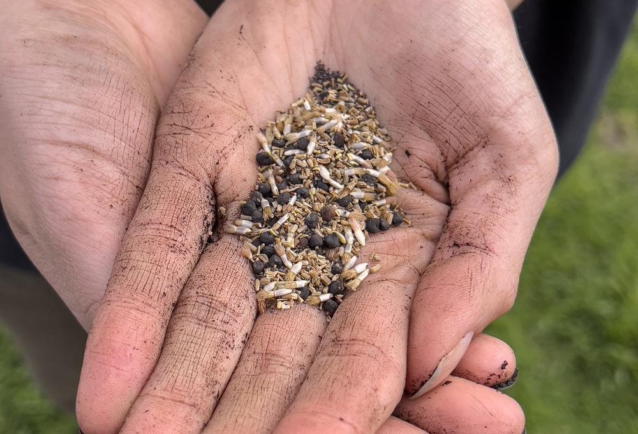
Preparing your chosen spot for planting…
How to plant your seeds
Sow them in a sunny spot (that doesn’t already have wildflowers growing).
Prepare the ground by digging and raking until the soil is fine and crumbly.
Sow the seeds on the surface.
Gently rake over the seeds, then press them down with the back of the rake.
Water them in dry weather.
When to plant wildflowers
The best time to sow is in Autumn (late September/October) when wildflower seeds would naturally drop. This way they will be in tune with their natural cycle and nature will water them for you!
https://www.edenproject.com/learn/schools/how-to-grow-wildflowers-in-your-school

Slide 13
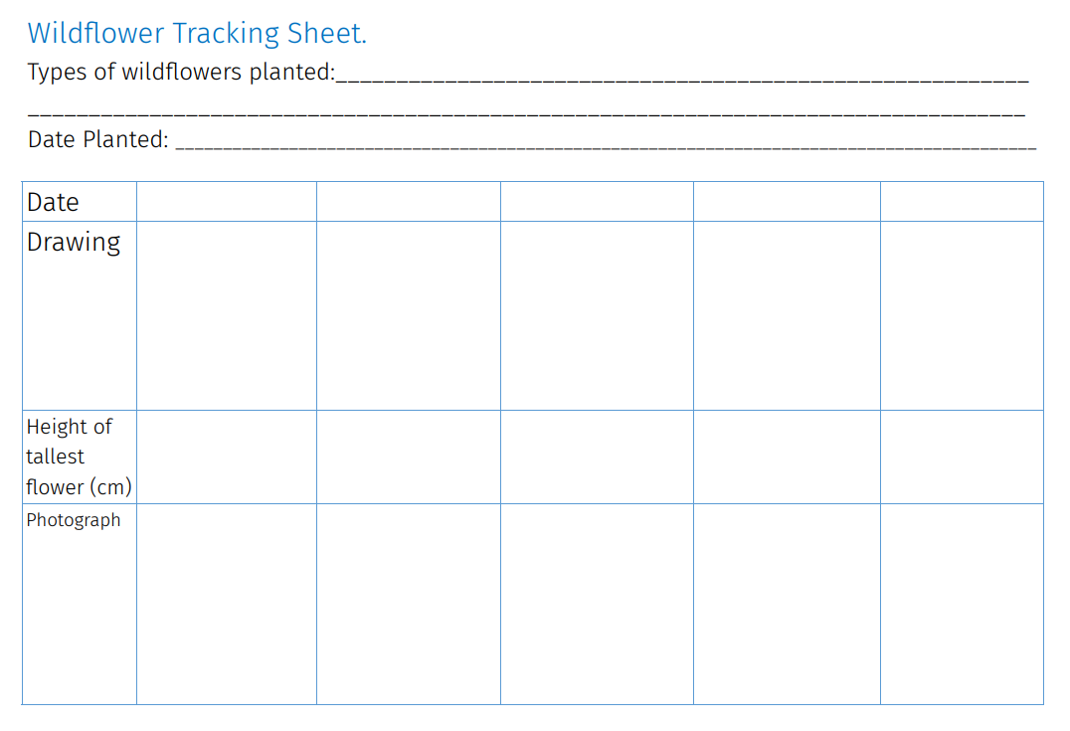
Tracking your plants’ growth
Use the tracking sheet to record your wildflowers as they grow.
Make sure you visit your wildflowers lots of times throughout the season (and throughout the year).
Each time you visit, record their growth by drawing pictures and measuring the height of the tallest flowers. It would also be a good idea to take a photograph of you with your flowers (this will help you notice seasonal changes).

Slide 14
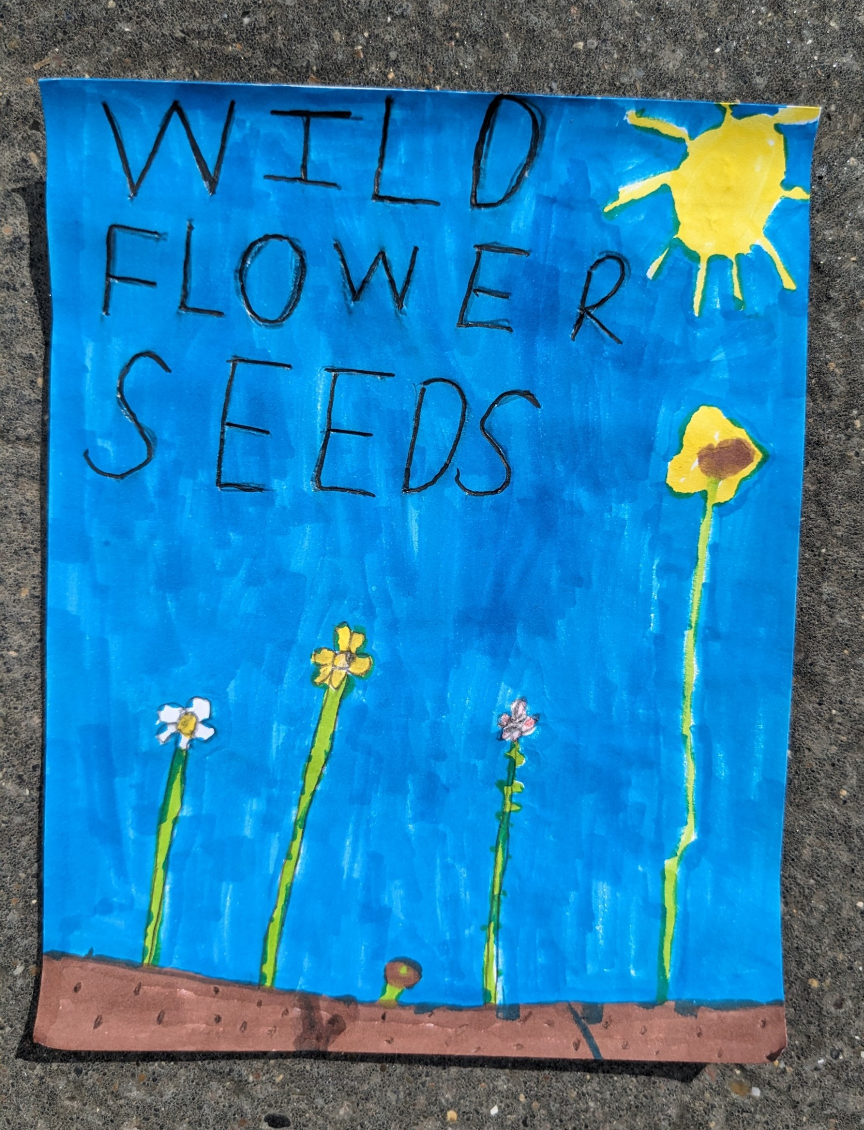
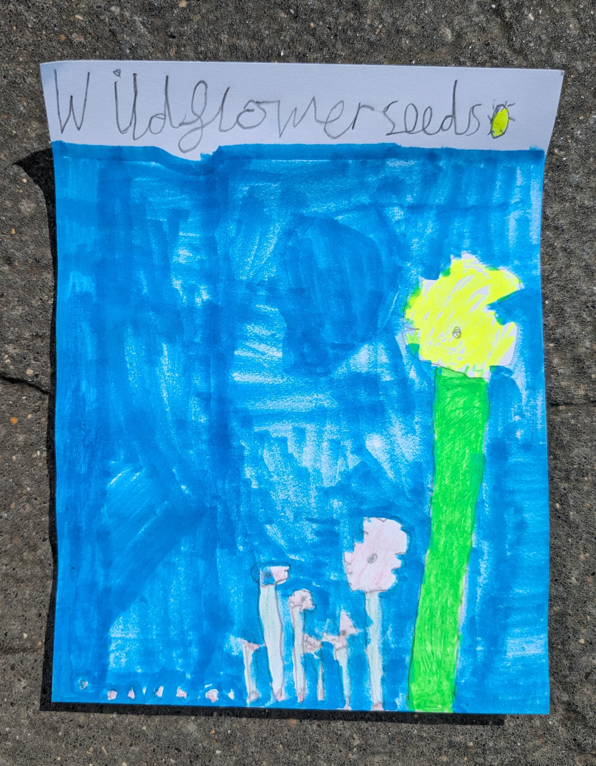
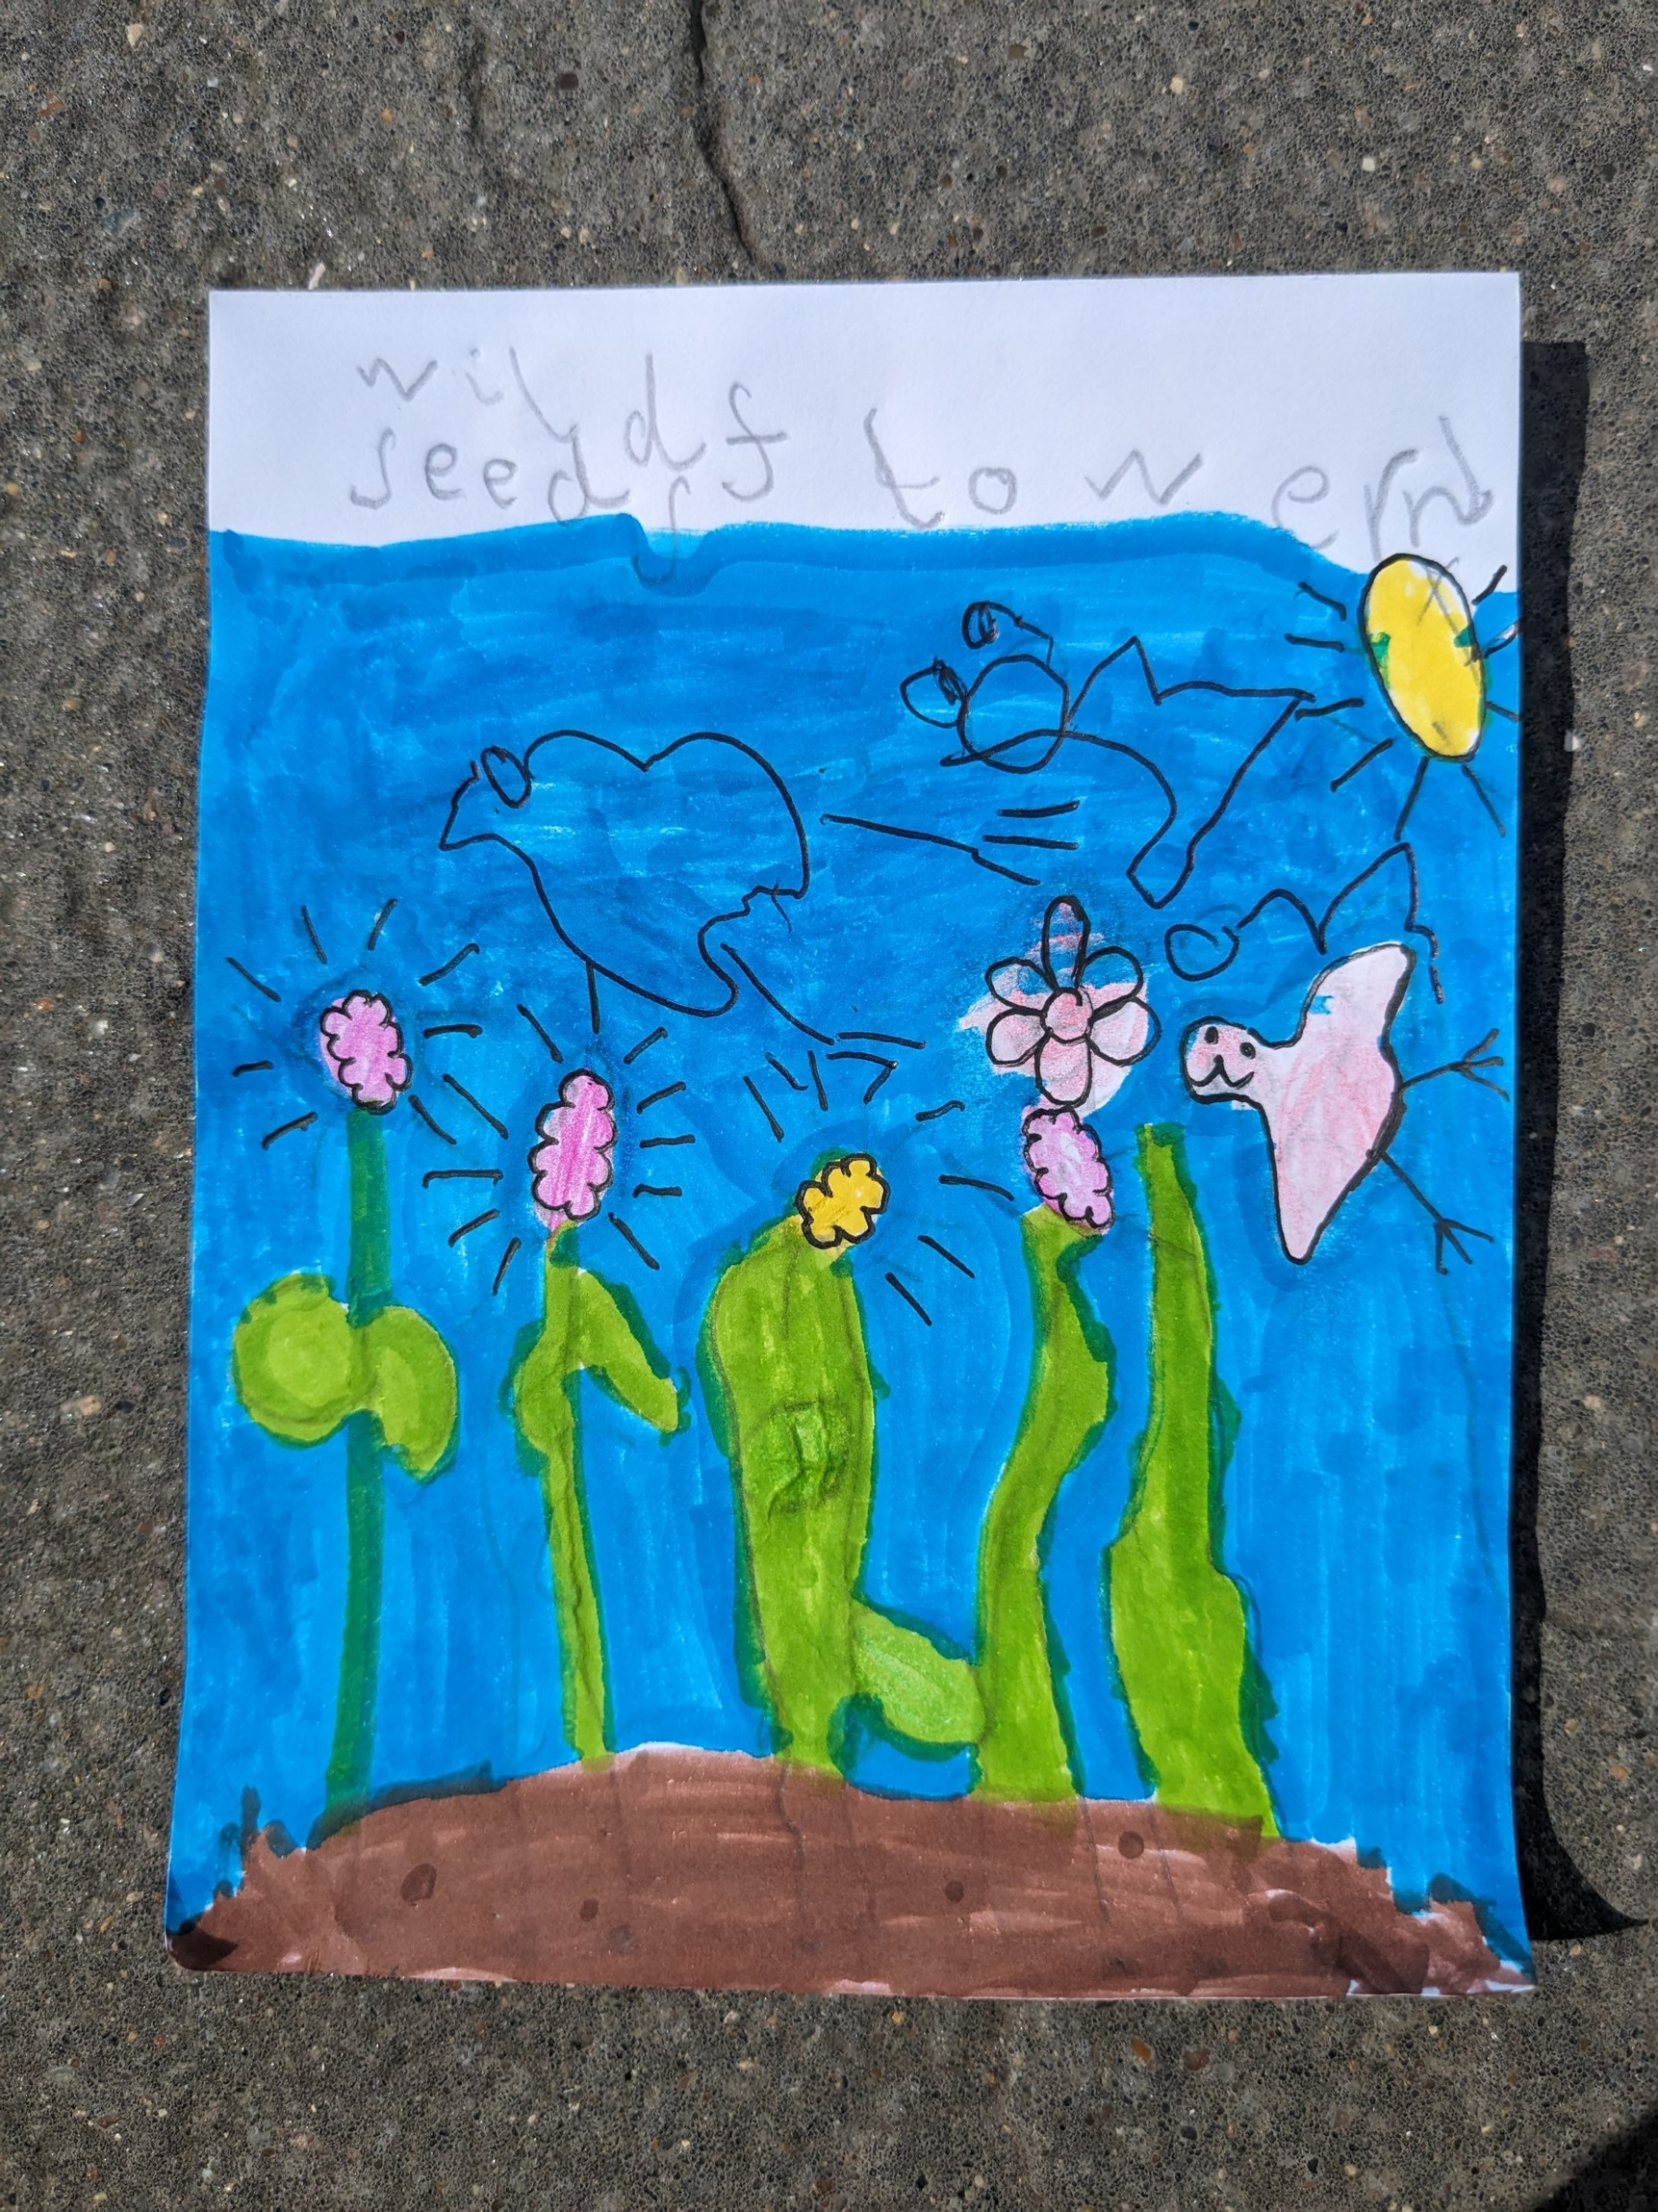
What next?
Having observed your wildflowers complete their life-cycle, why not harvest the seeds and share with your community? This is actually quite easy to do!
How?
When the seed heads have dried and turned brown, you can either snip them off with a pair of scissors or shake the seeds from the heads into an envelope. Store the envelope in a cool, dry place (such as in an air tight container in your fridge).
You could even design seed packets to use when sharing your seeds:

